Slide 1
Welcome day of Economics, Management, Mathematics, Physical and Computer Sciences Doctoral School
NOVEMBER 25th, 2021

Slide 2
Economics, Management, Mathematics, Physical and Computer Sciences Doctoral School
Director: Laurence Jacquet (prev. Director: Gabriel Desgranges)
5 research laboratories
Economics and management : THEMA and ESSEC research center Mathematics : AGM
Physical : LPTM Computer Sciences : ETIS
- 155 doctoral students enrolled in 2020-2021
- More than 280 teachers-researchers and researchers in 3 schools (CY, ESSEC, ENSEA)
- 26 thesis defended in 2018
Notes:
Gabriel

Slide 3
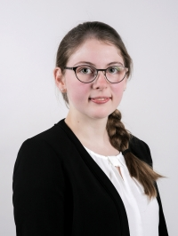
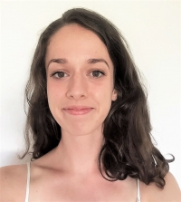
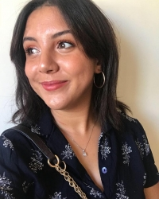
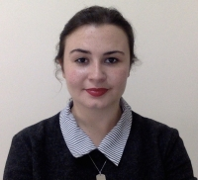
EM2PSI Doctoral School Board
Elected students
25 members including:
13 faculty staff
2 BIATSS
5 PhD students
5 external members
→ At least 3 meetings/year
- Emeline Deneuve : aemeline.deneuve@essec.edu
Gabrielle Gambuli : gabrielle.gambuli@gmail.com
Aïcha Ramza: aisha.ramza@gmail.fr
Margaux Suteau : margotsut@gmail.com
Hélène Iung: b00748811@essec.edu
Anderson Vil: vladerinson@gmail.com
Emeline Deneuve, ESSEC
Gabrielle Gambuli, THEMA
Aicha Ramza,THEMA
Margaux Suteau, THEMA
Notes:
Doctorants élus
Lancer les élections des doctorants représentants.

Slide 4
Roles and responsibilities
The Doctoral College and the Doctoral School:
Ensure good financial, material and environmental conditions
Contribute to the scientific exchanges between the DS laboratories and external researchers (conferences, mobility)
Provide a training program
Promote and follow the professional integration of the PhD students
The laboratory director :
Contributes to the scientific and material integration of the PhD student
Is the referent person for the organization of the thesis committees
Is the first person to contact in case of conflict

Slide 5
Roles and responsibilities
The supervisors :
Define the objectives and work schedule
Accompanies the thesis work of the PhD student
Organize regular meetings
Ensure the dissemination of the research results
Is concerned with the professional career of the PhD student
The PhD student :
Implements all the means required to complete the thesis project
Regularly informs his/her supervisors of the research results and possible difficulties
Produces written documents (laboratory notebook, reports…)
Follows the formations proposed by the Doctoral School

Slide 6
1.THE THESIS PROJECT
Recruitment
Research project management
Defense
Mobility
Professionnal project
Training
Professionnal integration
RESEARCH PROJECT
PROFESSIONNAL PROJECT
Notes:
Perrine

Slide 7
2.The key steps of the PhD thesis
Registrations
Re-Registrations
From july 10th to November 15th
Training
All along the PhD thesis
Thesis committee
From the 2d year onwards
Defense
Mobilities & Conferences
Additional activities

Slide 8
2.1 The key steps of the PhD thesis
Registration
In 2^{d} or 3rd year : july to october 15th
Doctoral contract : before september 15th
Other : before october 15th
4rth year or more (not recommended) : before october 15th

Slide 9
Mid-term committee :
2.2 The key steps of the PhD thesis
Organisation
before july 31th of the 2d (or later) year
required for registration in the next year
organized at the lab. level
Committee members : 2 or more faculty members (internal or external)
NOT the supervisors (legal requirement)
An oral presentation of the work
to be prepared (send documents to committee)
followed by questions and comments
a written report by the committee
Objectives:
To check on the progress and scientific quality of the thesis’ work
To ensure that the PhD thesis goes smoothly (supervising, work environment)
To ensure the dissemination of the research results (articles, conferences)
To discuss the professional project

Slide 10
2.3 The key steps of the PhD thesis
All along the thesis:
Doctoral missions (teaching...)
Training courses (in or off-catalogue)
Financial support from the Doctoral School for (to be discussed with supervisors and lab director)
Conference participation
mobility in a foreign laboratory (Ordre de mission nécessaire)
Call from the doctoral college for International mobilities (In/out Europe)/ Fullbright program
In case of difficulties/conflict:
The thesis committee can be convened
The head of Doctoral School can be contacted
Thesis defense:
Before December 31th to prevent registration in the next year
The manuscript and jury/date of defense have to be submitted (« déposée » to the Doctoral School (via ADUM) 10 weeks before the date of defense.
Qualifications (for « maître de conférences ») : Defense before November 15th (exact date changes every year)

Slide 11
2.4 The key steps of the PhD thesis
If the thesis defense is not planned before December 31th :
A new mid-term committee must be organized before September 30th : required for registration in the 4th year (before October 15th)

Slide 12
Intellectual property and knowledge dissemination
Points to keep in mind when doing your research
Maintain confidentiality:
About your research in the lab
On any third party information you come across during your research
Do not give information on social networks
Respect every confidentiality clause, e.g. from your funding partner.
Comply with publication rules
Refer to CY as your host institution in your publications. Follow the terms of the Dissemination Charter (and possibly partners in a collaboration)
Like any CY employee, inform your Institution of any of any invention that may lead to a patent.
Researchers' inventions belong to their employers (economic rights)
Inform the employer by completing a declaration of invention (PIVA service).
Inventors are always referred to as such on a patent (moral rights).
Notes:
Je vous renvoie sur la charte des thèses que vous avez signé lors de votre inscription .
Garder la confidentialité:
Sur vos recherches au sein du laboratoire
Sur les informations de tiers dont vous pourriez avoir connaissance lors de vos recherches en laboratoire
Ne pas diffuser d’information sur les réseaux sociaux
Respecter les clauses de confidentialité imposées par le financeur
Respecter les règles de publication
Obligation de mentionner CY selon les modalités de la Charte de diffusion (et éventuellement les partenaires dans le cadre d’une collaboration)
Comme tout employé de CY, informer de toute invention qui pourrait faire l’objet d’un dépôt de brevet
Les inventions des chercheurs appartiennent à leur employeur. (droits patrimoniaux)
Informer l’employeur en complétant une déclaration d’invention (service PIVA)
Les inventeurs sont toujours indiqués comme tels sur un brevet (droits moraux)

Slide 13
Doctoral missions
Annual campaign of doctoral missions between May and September
Missions |  | Duration | Application Form
Teaching |  | between 60h and 64h | Teaching assignment
Non-teaching | expertise | 32 days | Non- teaching assignment
 | communication
 | IP exploitation
Application for teaching assignments outside the annual campaign
Duration ˂ 60h = « Demande d’autorisation de cumul » => « VACATIONS »
Applications for teaching assignment in another university
« Demande d’autorisation de cumul » = « vacation » paid by the other institution
Contact : missions.cumul@ml.u-cergy.fr
Notes:
Une mission à l’UCP doit obligatoirement être de 60 à 64 HeTD.
Pour tout volume d’heures en dessous de 60 HeTD, les heures seront payées comme des vacations et vous devrez remplir une demande d’autorisation de cumul (https://intranet.u-cergy.fr/IMG/pdf/Cumul_contractuels_doctorants_4_.pdf)
Le tarif d’une heure supplémentaire est 41,41€, donc il n’y a pas d’inégalité entre une heure en mission et une heure en cumul.
MAIS
Vous ne serez payé que sur service fait
Vos heures de TP ne seront pas comptées équivalentes HeTD, mais 1h TP = 2/3 HeTD).

Slide 14
Disciplinary trainings

Slide 15
Joint thesis supervision agreement
Thesis project in collaboration with a foreign higher education institution
Allows to obtain the 2 diplomas of the 2 institutions / 1 single defense
The agreement must be signed within 18 months after the first registration.
Stay of at least 1 year at CY Cergy Paris University
Enrollment/re-enrollment in both institutions
At the initiative of the Thesis Director in agreement with the laboratory director and the director of the Doctoral School

Slide 16
The Label « Doctorat Européen » or « DOCTOR EUROPEUS »
At least 3 months of mobility in a laboratory in another European country
At least 1 member of the jury belongs to an institution in a European country other than the country of the defense
At least 3 rapporteurs , including 2 from institutions in 2 European countries other than the country of the defense
Part of the defense in an official EC language other than the country of defense

Slide 17
Save the dates
Fresque du climat pour les doctorants : January, 21th 2022
Bulles de chercheur.e.S : January 24,25,26 th 2022
MT180 Local final : Mars, 11th 2022
Prix des Femmes et des Sciences 2020 : Mars 11th 2022
Creation & Innovation seminar: November 2022
Notes:
Perrine

Slide 18
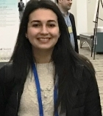
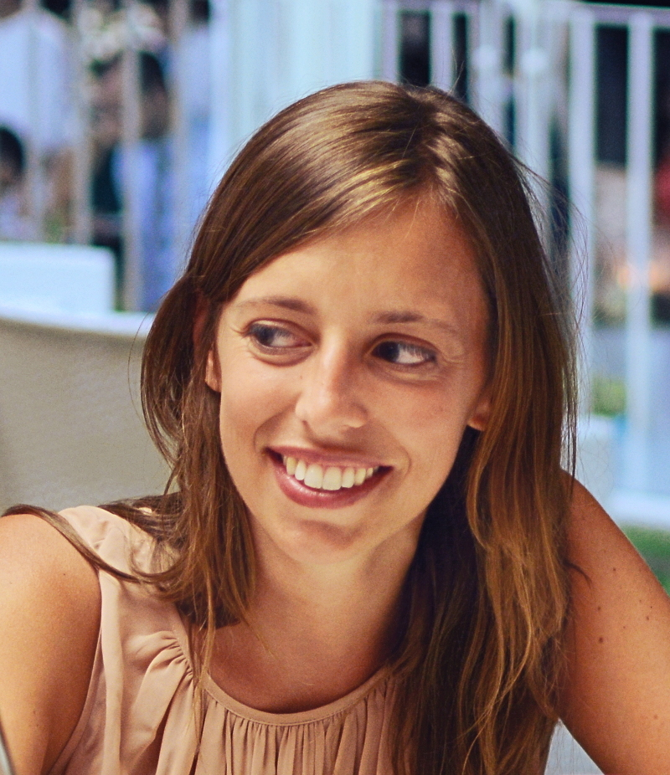
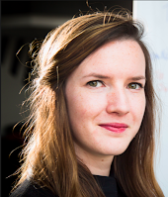
« Prix des Femmes et des Sciences »
(awards for women in science) –CY Alliance
- PhD category (2nd/3rd year PhD)
- 1 000€ for the research of each winner (mission, computer,…)
- very light application, deadline January 31th
- announced march 8th, awarded at MT180 final (march 11th)
Previous winners:
Morgane Robichon (LCB, 2021) Hadjer Ouldali ( LAMBE, 2020) G. Cervia (ETIS, 2019) A. Adeline (Thema, 2018)
Notes:
L'idée est de leur dire de candidater dans 1 ou 2 ans et de dire aux doctorantes de leur labo de
candidater.

